Slide 1

RV College of
Engineering
Autonomous Poisonous Gas Detection System implemented through RC Vehicles
1
Notes:
1

Slide 2

Introduction
This project combines agility of RC vehicles with advanced gas detection capabilities, creating a mobile platform capable of navigating complex industrial environments. The integration of specialized gas sensors equips the RC vehicle with the ability to identify and monitor a variety of poisonous gases, enabling real-time data collection for swift response and intervention.
2

Slide 3
Functionality
RC Navigation
Graphing
User Interface and Alerts
Realtime Gas Detection
Wireless Communication
Efficiency

Slide 4
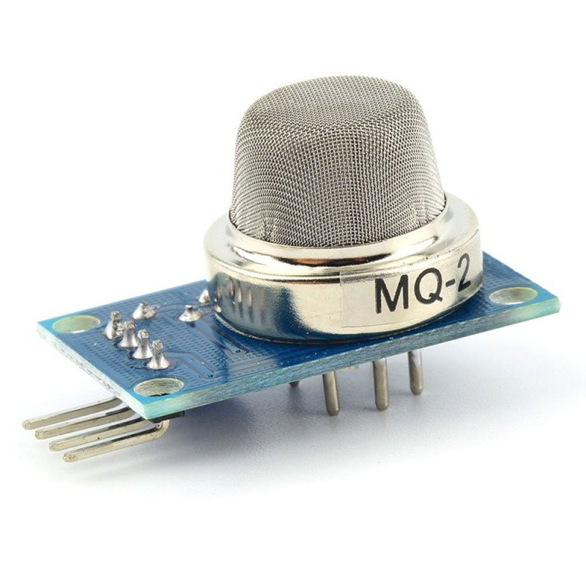
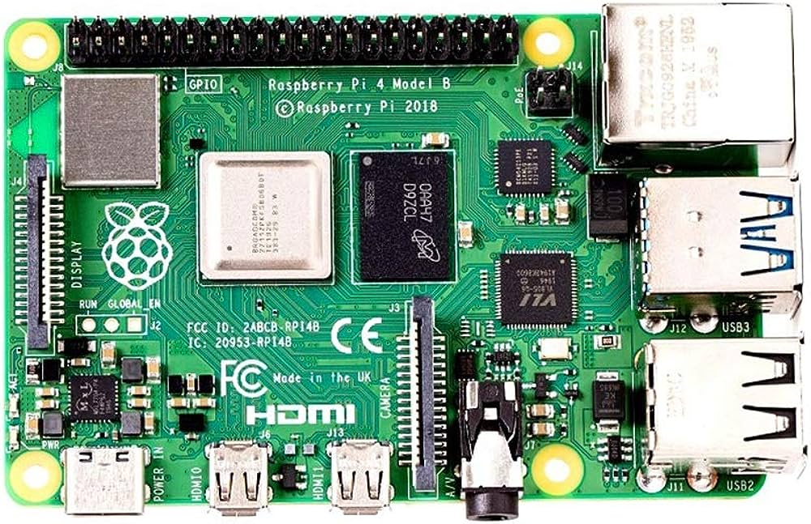

Materials and methods
MQ 2 (LPG – Butane, Propane, Smoke)
Raspberry Pi Model 4B - The Raspberry Pi is a versatile, credit card-sized single-board computer developed by the Raspberry Pi Foundation. It features GPIO pins for hardware interfacing, supports various operating systems, and is widely used for DIY projects, education, and as a cost-effective platform for embedded computing.
MQ 136 – H2S
4

Slide 5

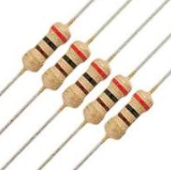
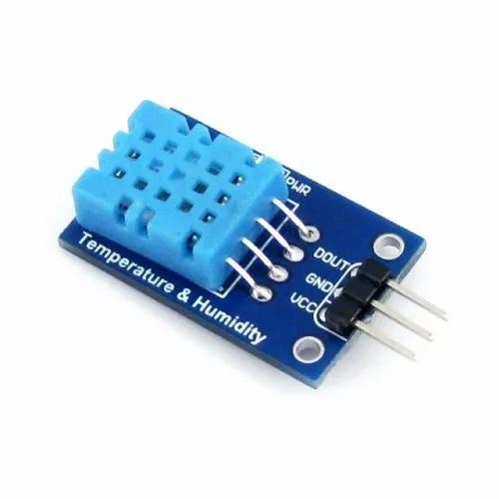
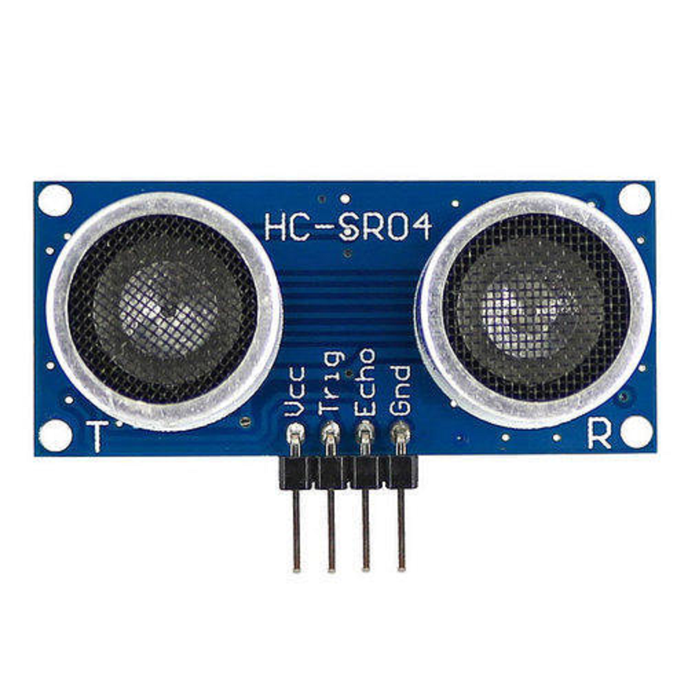
370 ohm resistor
DHT 11 temperature sensor
HC SR04 ultrasonic sensor
MQ 137 - Ammonia

Slide 6
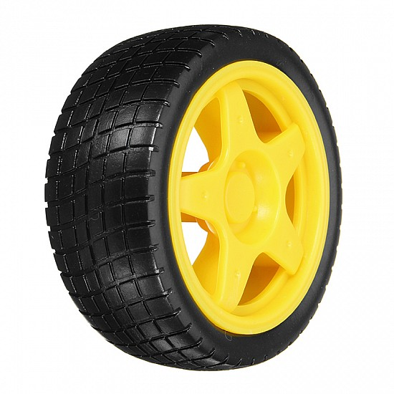

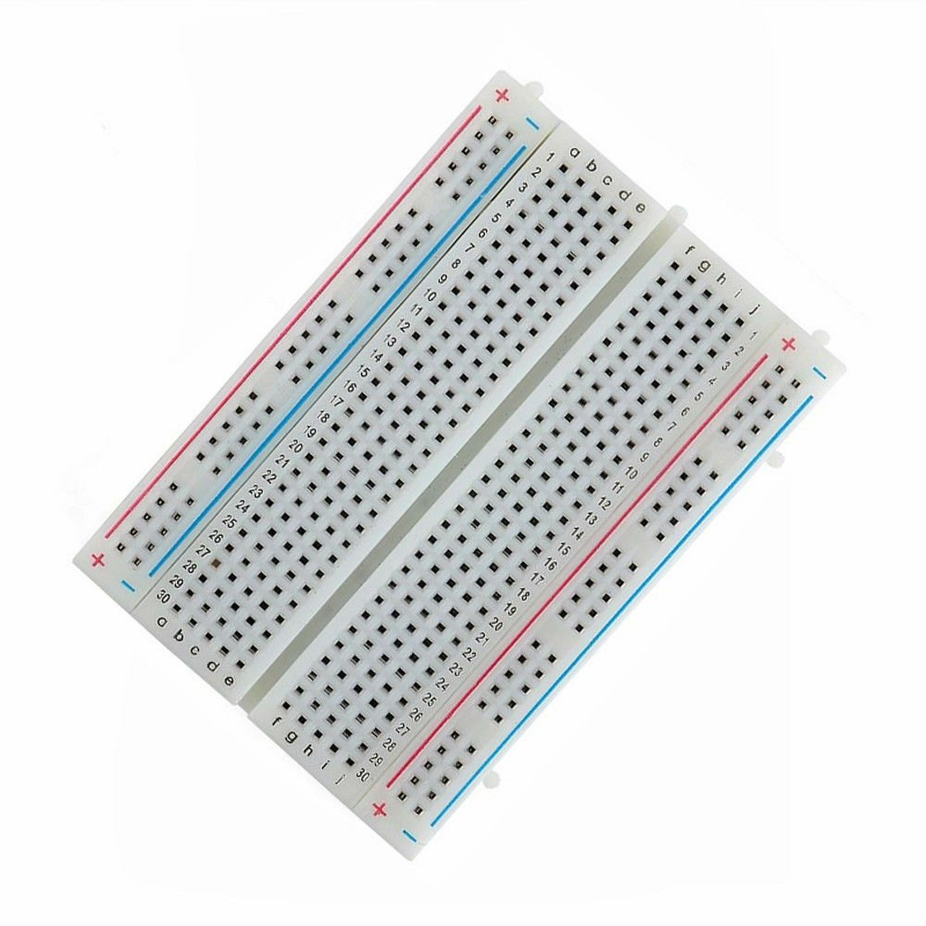
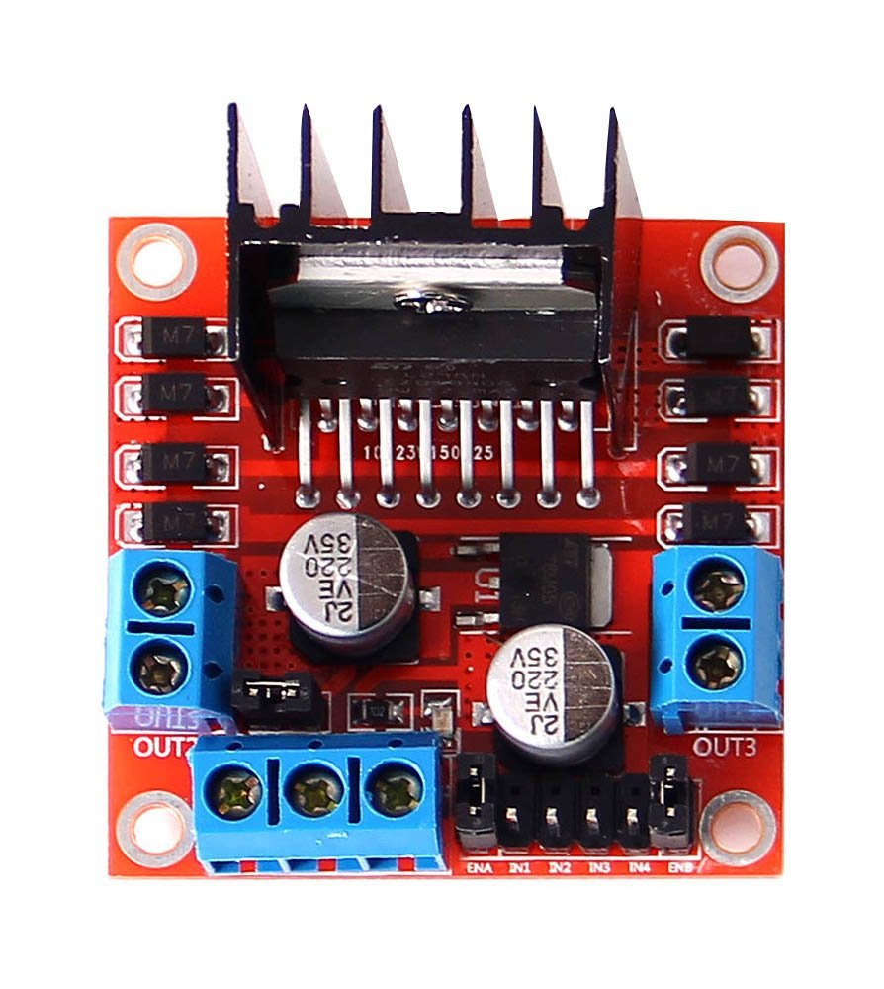
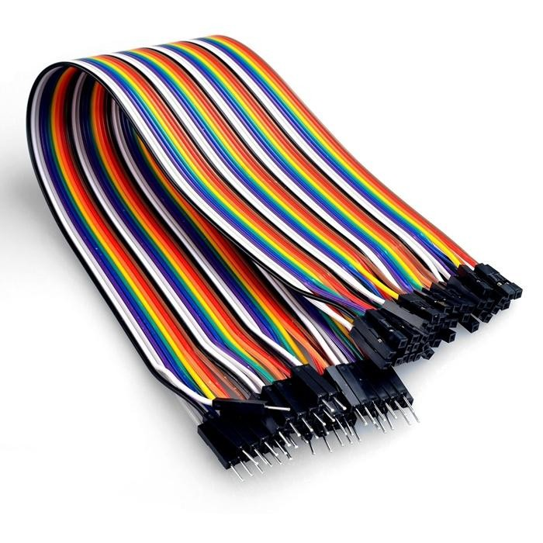
Wheels
Power bank
Breadboard
L298N motor driver
Jumper wires

Slide 7
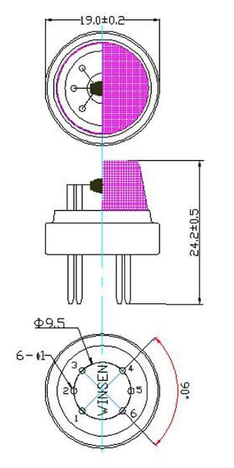
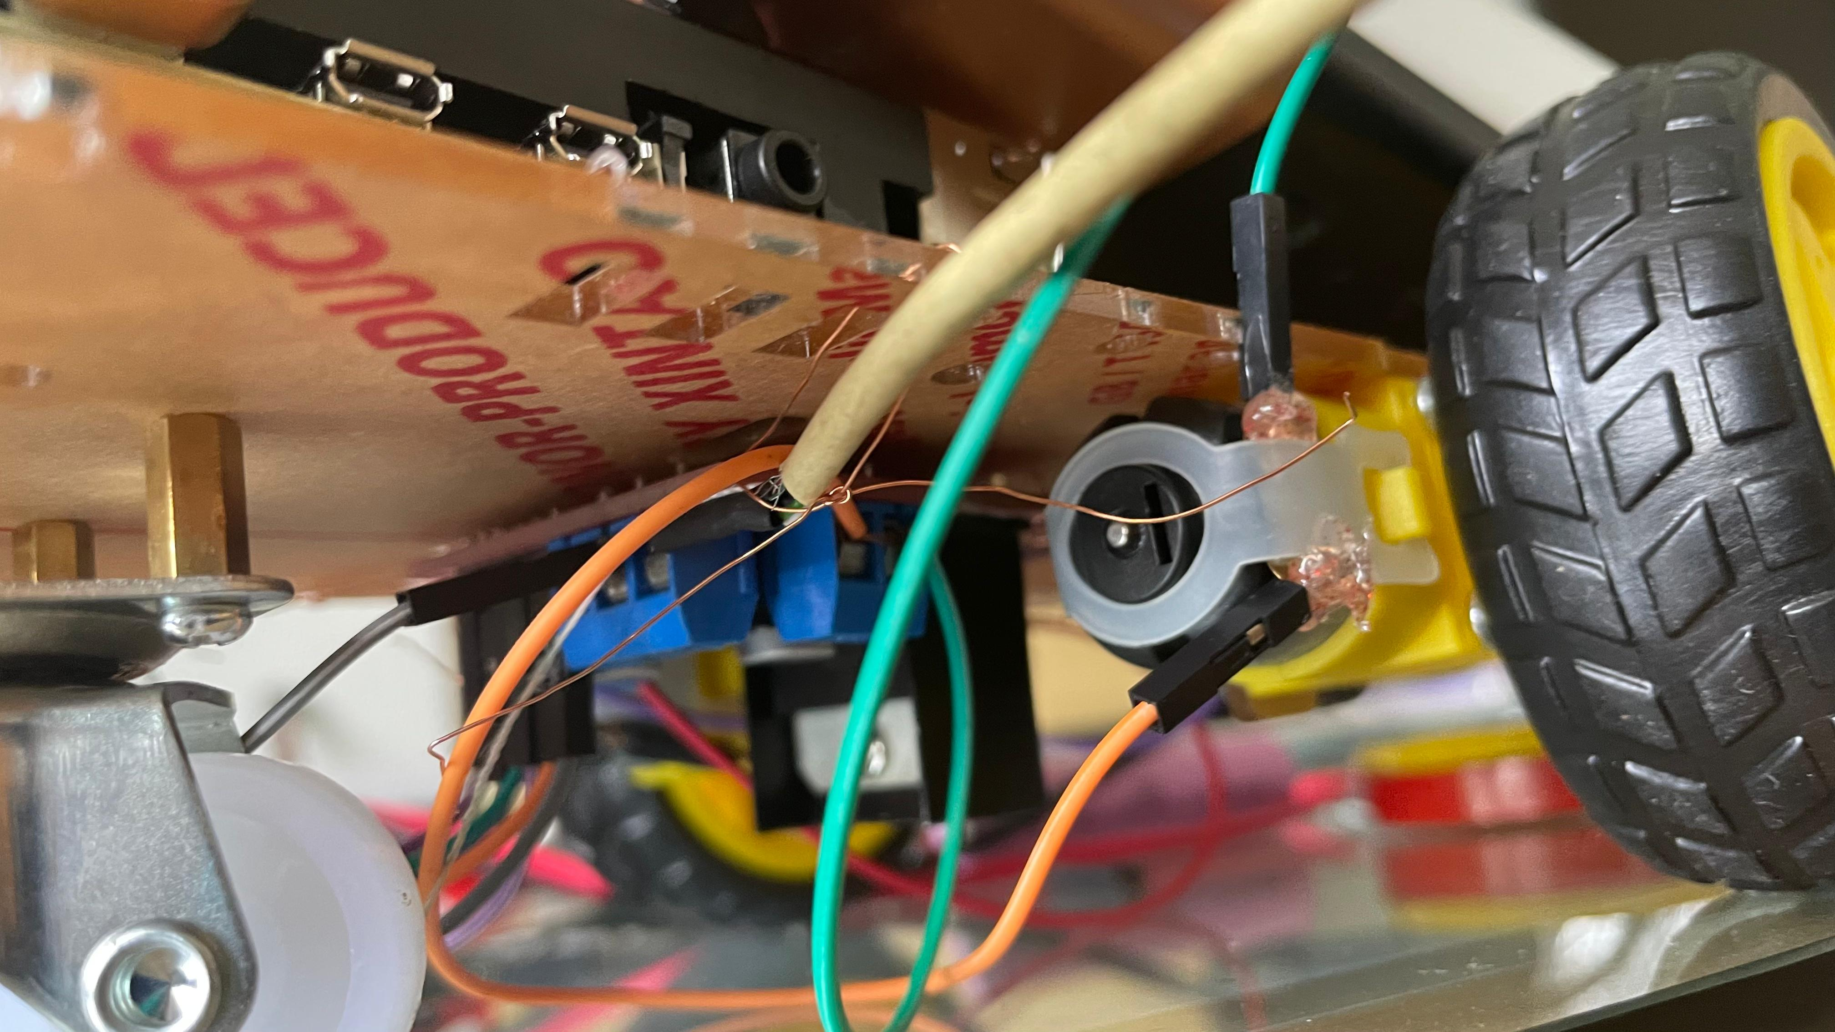
Sensor
Raspberry Pi
Output
Data Processing and Wireless Communication

Slide 8
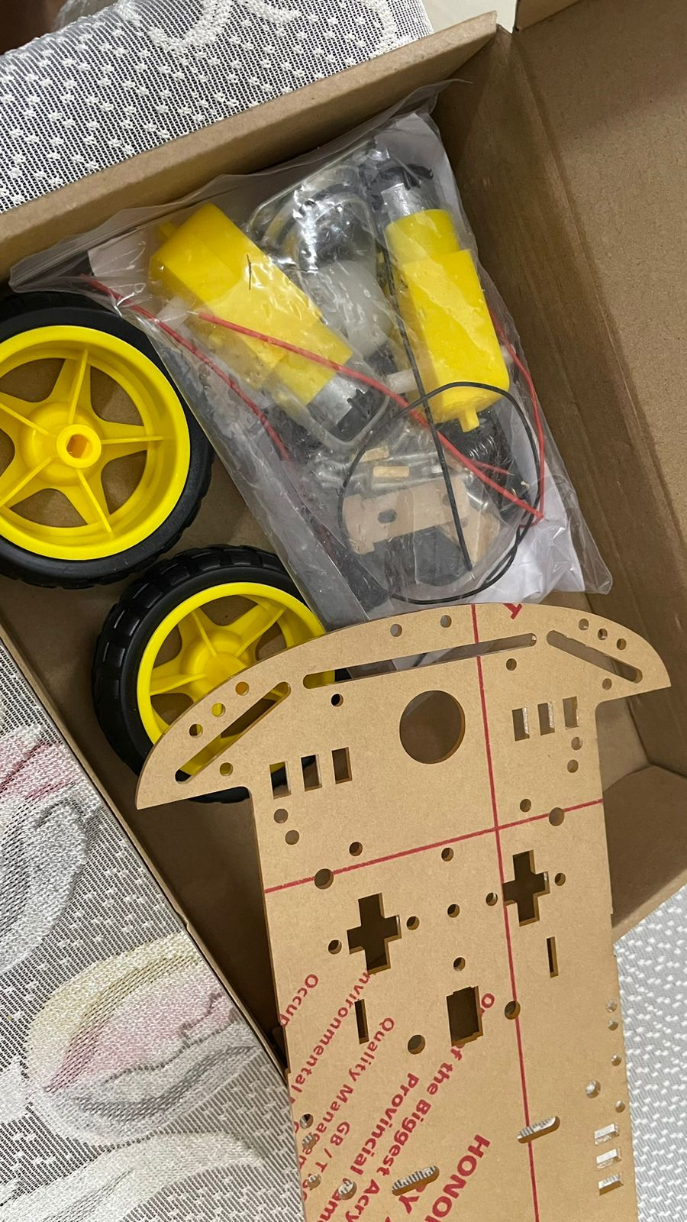
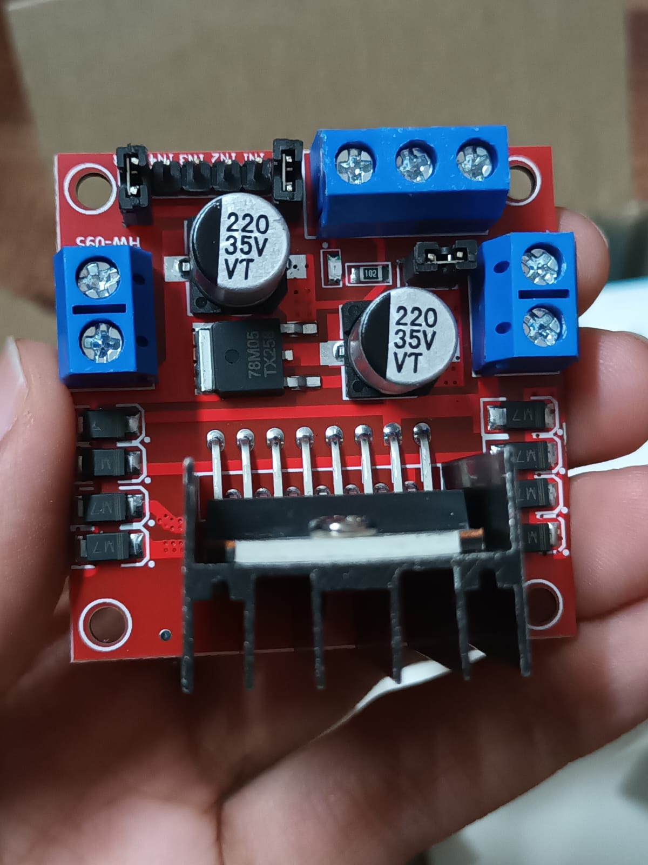
New chassis
L298N motor driver

Slide 9
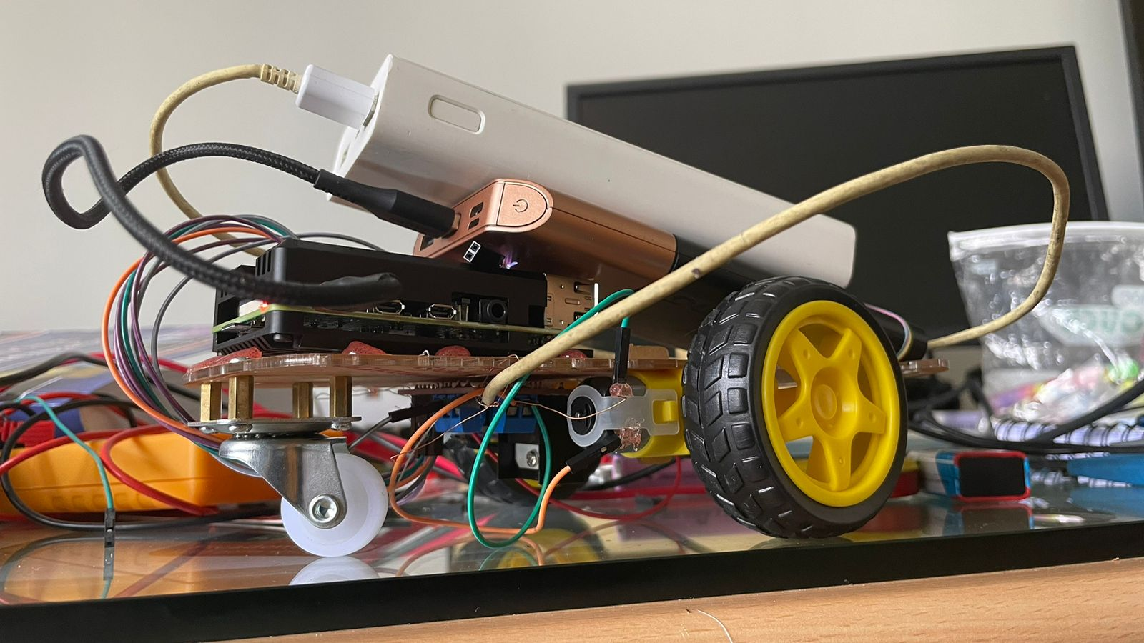
INITIAL MODEL

Slide 10
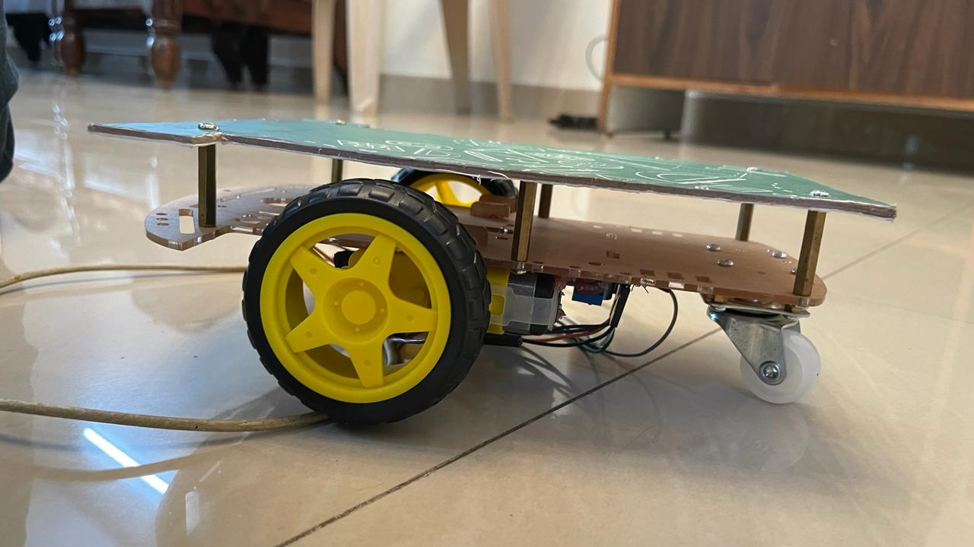
CHASSIS MODIFICATIONS
Addition of a second platform using hex mounts and screws
Platform made of hard cardboard
Wheel alignment
Wire management done using spaces in chassis
Model stabilization done after load balance visualisation

Slide 11
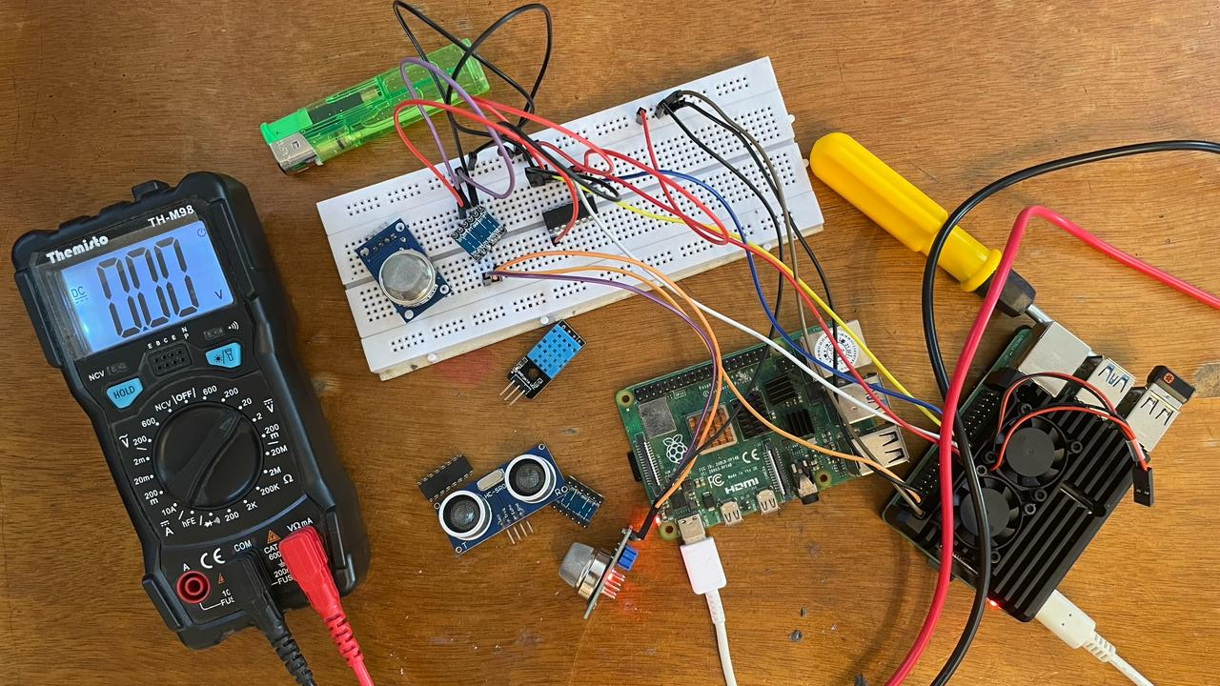
Sensor calibration and sensitivity adjustments performed
Raspberry pi interfaced with sensor using intermediatory voltage shifters and analog to digital convertors
Voltages thoroughly monitored for changes

Slide 12
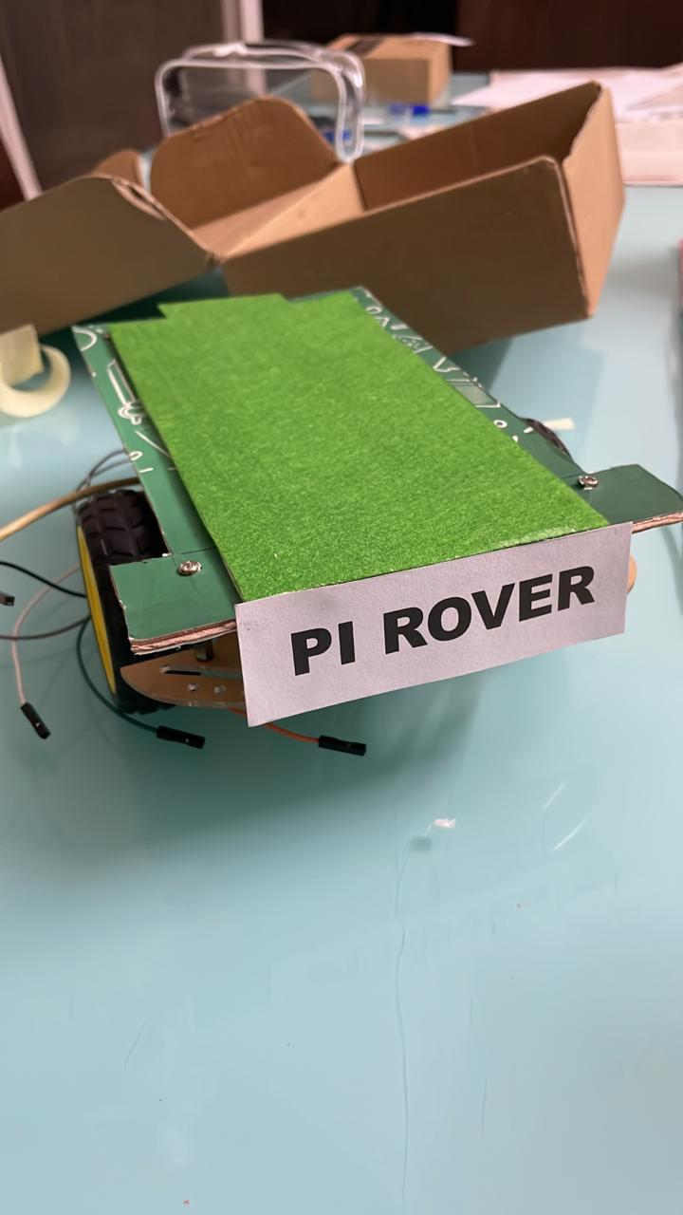
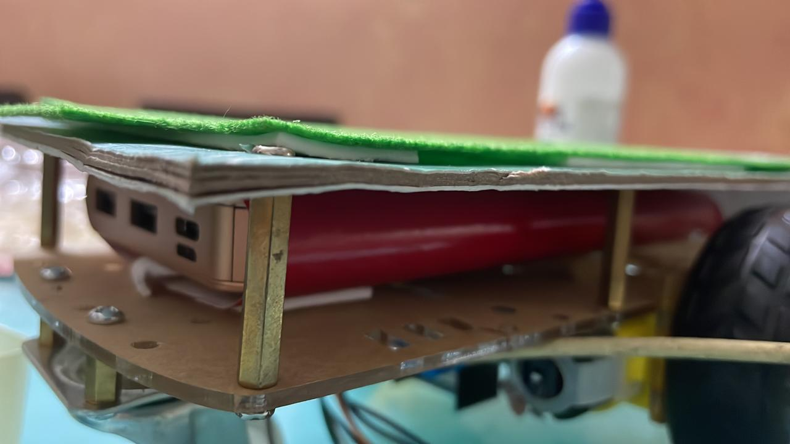
Model surfaced with anti static layer to prevent damage to electronic components.
Accessories securely fastened to chassis to prevent damage
Motor driver wires separated for easy error identification
First level dedicated to battery pack
Battery components firmly attached to chassis for added stability and minimal vibration

Slide 13
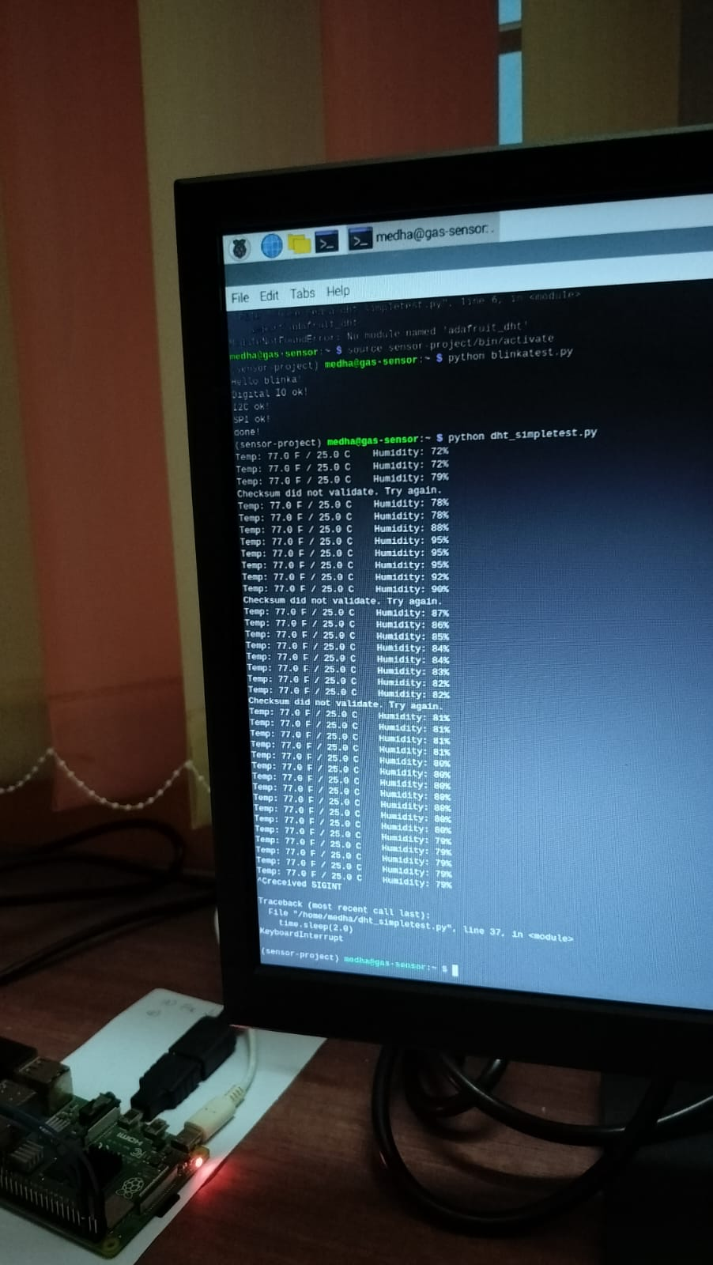
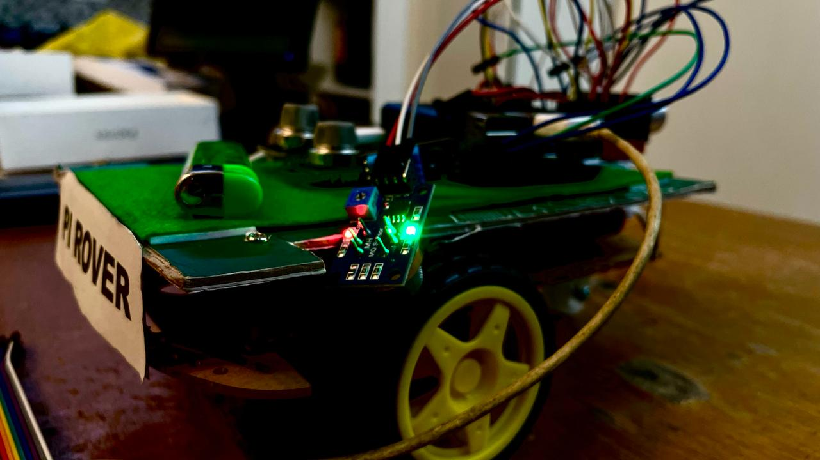
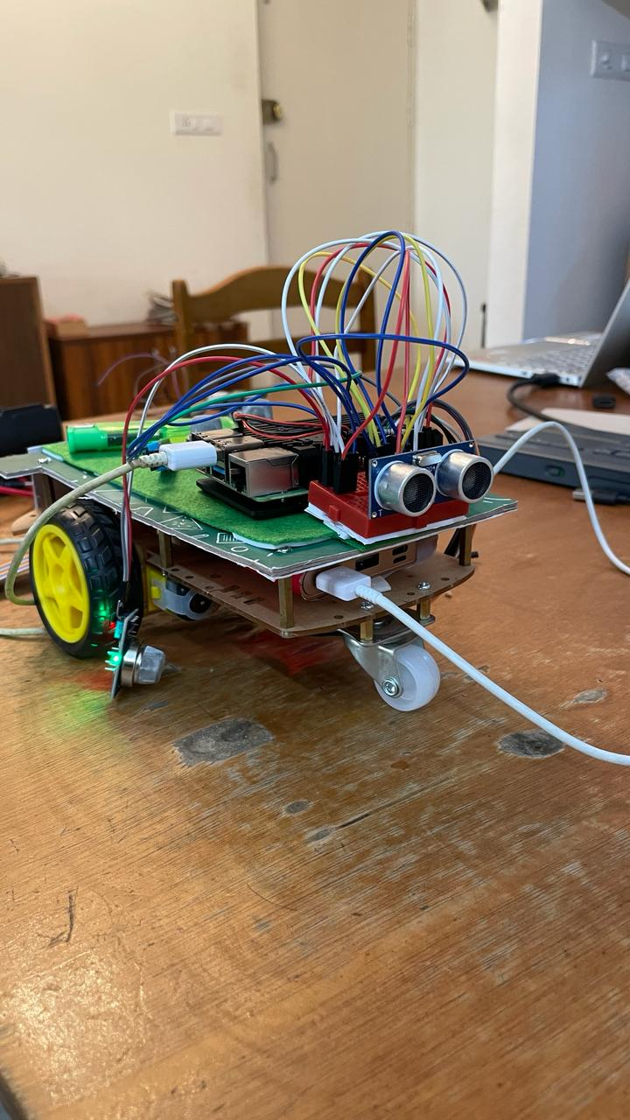
Mounted ultrasonic sensors for testing under different conditions
Temperature sensor readings
Final model accessory arrangement

Slide 14
References
Carbon Monoxide Sensing Technologies for Next-Generation Cyber-Physical Systems by: Turja Nandy, Ronald A. Coutu Jr, Cristinel Abebei [Department of Electrical and Computer Engineering, Marquette University, Milwaukee, USA] published:13th October 2018 in MDPI https://www.mdpi.com/1424-8220/18/10/3443
Selective detection of methane and butane by temperature modulation in iron doped tin oxide sensors by: S Chakraborty, A.Sen, H. S Maiti. [Sensor & Actuator Section, Electro-ceramics Division, Central Glass and Ceramic Research Laboratory, Kolkata,India] published in Sensors and Actuators B: Chemical https://www.sciencedirect.com/science/article/pii/S0925400505008543
Ammonia sensors and their applications – a review by Bjorn Timmer, Wouter Olthuis, Albert Van den berg. [MESA⁺ Research Institute, University of Twente, The Netherlands] published in Sensors and Actuators B: Chemical https://www.sciencedirect.com/science/article/pii/S0925400504008196
Hydrogen Sulphide detection: The paper by Fajr I. M. Ali , Falah Awwad , Yaser E. Greish , and Saleh T. Mahmoud [University of UAE, UAE] published in IEEE https://ieeexplore.ieee.org/abstract/document/8571291/
Embedded system for Hazardous Gas Detection and Detection (International Journal of Distributed and Parallel Systems) By V. Ramya and B. Palaniappan (Department of CSE, Annamalai university, India)
Review of recent progress on graphene-based composite gas sensors and existing gas-sensor technology:in Ceramics International Journal by – Chenyang Wang, Yanyan Wang, Zhi Yang, Nantao Hu [School of Optoelectronic Science and Engineering & Collaborative Innovation Centre of Suzhou Nano Science and Technology, Soochow University, Suzhou, 215006, PR China] https://www.sciencedirect.com/science/article/abs/pii/S027288422100506X
Multi-agent based wireless network system for fire and poisonous gas detection: by Zhijun Gao, Hongyu Wang, Chunyan Xue, Di wang [School of Information and Communication Engineering, Dalian University of Technology, Dalian, China] published in IEEE.https://ieeexplore.ieee.org/abstract/document/6260334/authors#authors
IoT Based Remote Monitoring of Gas Leakage in Power Plants by : T.Kalavathi Devi, Neelam Sanjeev Kumar, Gokul Chandrasekaran, P.Sakthivel etc published in IEE https://ieeexplore.ieee.org/document/10150136
Wikipedia https://www.wikipedia.org/
14

